Slide 1
Steps followed to Build a Model:
Load the data
Data Cleaning and Data Preparation
Feature Engineering
Exploratory Data Analysis
Important Business Findings
Model Building
Selecting Best Model w.r.t Accuracy and Feature Importance
1
2
3
4
5
6
7

Slide 2
Raw Data with all Features:
Understanding the data:
Features Eliminated:
Sr No. | Feature | Data Type | Non-Null values
1 | Id | integer | 52236
2 | First_date_seen | object | 52236
3 | Last_date_seen | object | 52236
4 | vin | object | 41662
5 | year | integer | 52236
6 | make | object | 52236
7 | model | object | 52236
8 | trim | object | 48507
9 | mileage | float | 52129
10 | price | float | 52232
11 | color | object | 48810
12 | body_type | object | 48624
Sr No. | Feature | Data Type | Non-Null values
13 | drivetrain | object | 49503
14 | transmission | object | 50119
15 | fuel_type | object | 51102
16 | engine | object | 39242
17 | passengers | float | 21987
18 | description | object | 47999
19 | carfax_url | object | 25364
20 | is_private | boolean | 52236
21 | seller_name | object | 52220
22 | city | object | 52236
23 | province | object | 52236
24 | longitude | float | 52236
25 | latitude | float | 52236
Sr No. | Features Eliminated
1 | First_date_seen
2 | Last_date_seen
3 | Year
4 | Model
5 | Color
6 | Seller_name
7 | Latitude
8 | Longitude
Data Cleaning:
Considering years from 2000 to 2021.
Removing null values from important features.
Grouping various categorical features.
Removing Prices lower than 1500$.
Adding features by Feature Engineering.
Shape of the data:
Data Overview:
Vehicles dataset with 52236 rows and 25 features from 2nd April,2021 to 3rd May,2021 for Clutch with categorical and numerical variables.
Data | Rows | Columns
Before Cleaning | 52236 | 25
After Cleaning | 43945 | 17
Data Cleaned | 8291 rows(15.87%)

Slide 3
Exploratory Data Analysis and Understanding the data:
Feature Engineering:
Sr No. | Features Added
1 | Age of Car
2 | Car Situation
3 | Difference
4 | Price Category
5 | Mileage Category
Adding features using Feature engineering:
Price Category – Divide into 3 categories – Low, Medium, High.
Mileage Category – Divide into 3 categories based on priori – Low, Medium, High.
Age of car – Difference between car manufactured year and current year i.e. 2021.
Difference – Difference between first_date_seen to last_date_seen i.e. car is still with Clutch as of 3rd May, 2021.
Car Situation – If car is sold/unsold by Clutch as of 3rd May, 2021 i.e. last_date_seen.
Cleaned Dataset Statistics:
Problems with data:
No. of Variables | 17
No. of rows | 43945
Missing data(%) | 0%
Duplicate rows | 108
Numerical Variables | 7
Categorical Variables | 10
There are cars that are scrap and can never be resold just the parts of it can be sold so cannot be used for model building.
Trim, Engine and Color are not standardized.
Description has to be unified.
Nearly 25% of values in engine are missing and 58% missing in passengers.
Data is inconsistent as there are cars with 2022 in the year column.
Here, 108 duplicate rows are not removed because they weren’t duplicate in the actual dataset but seems duplicate after removing various features so there are more than one cars with similar features at different cities or with different sellers.

Slide 4
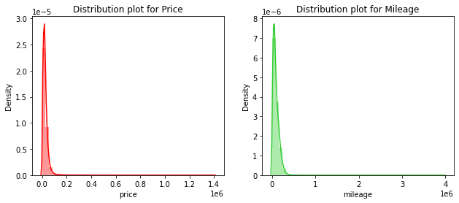
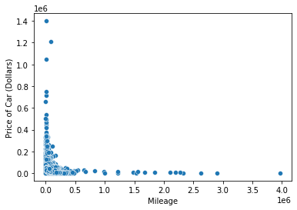
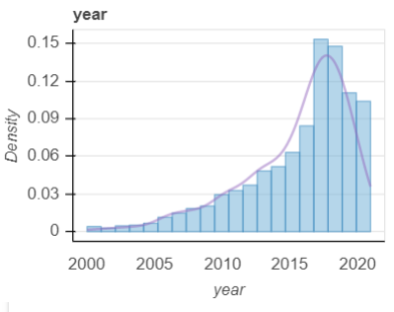
Relation between Price and Mileage:
Findings from the graphs:
The plot seems to be right skewed i.e. most prices in the dataset are low.(Median < Mean)
There is a significant difference between the mean and median of the price distribution.
Correlation between price and mileage is 0.37 by Pearson test.
Most cars that are to be sold belong to higher end of 2016 i.e. they are manufactured in last 5 years.
Other findings from the data:
Correlation | Age of Car | Mileage | Price
Age of Car | 1 | 0.65 | 0.39
Mileage | 0.65 | 1 | 0.37
Price | 0.39 | 0.37 | 1
Distribution of cars w.r.t Manufactured Year

Slide 5
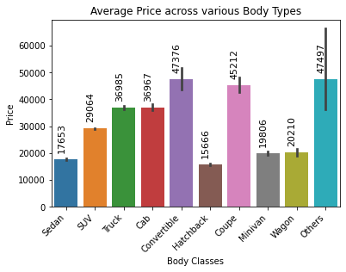
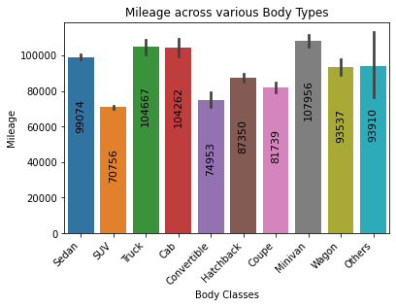
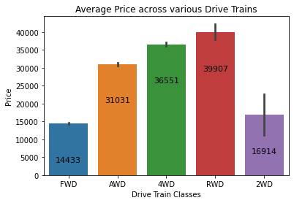
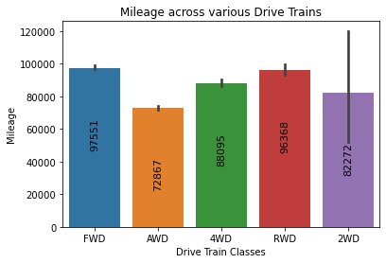
Exploratory Data Analysis to find Key Insights:
Average Price of cars across various body types
Average mileage of cars across various body types
Max Avg Price | Convertible
Min Avg Price | Hatchback
Max Avg mileage | Minivan
Min Avg mileage | SUV
Average price of cars across various Drive Train Classes
Average mileage of cars across various Drive Train Classes
Max Avg Price | RWD
Min Avg Price | FWD
Max Avg mileage | FWD
Min Avg mileage | AWD

Slide 6
Key Insights:
Tables here show count of cars with various categorical features and how much this could help overall business by knowing these insights.
Other Sellers >>>> Private Sellers
Seller Type | Cars Under Sell
Other Seller | 36317(82.64%)
Private Seller | 7628(17.36%)
Total | 43945(100%)
Cars Unsold ~ 2.3 times of Sold Cars (in 1 month)
Automatic Cars >>>> Manual Cars
Cars | Count of rows
Unsold | 30445(69.28%)
Sold | 13500(30.72%)
Total | 43945(100%)
Transmission | Count of cars
Automatic | 40950(93.18%)
Manual | 2995(6.82%)
Cars in Order of Fuel Classes:
Gasoline >>>>> Diesel > Hybrid > Electric > Other
Cars in Order of Mileage Category:
Low >> Medium > High
Fuel Classes | Percentage
Gasoline | 41704(94.90%)
Diesel | 898(2.04%)
Hybrid | 792(1.80%)
Electric | 317(0.72%)
Other | 234(0.53%)
Mileage Category | Cars Under Sell
Low | 29300(66.67%)
Medium | 11615(26.43%)
High | 3030(6.9%)
Order of Body Types: SUV > Sedan > Truck > Hatchback > Coupe > Minivan > Wagon > Cab > Convertible > Others

Slide 7
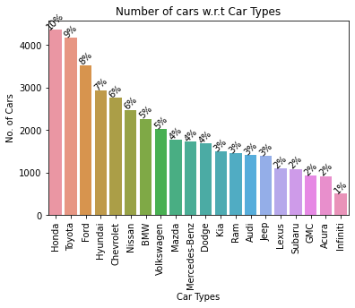
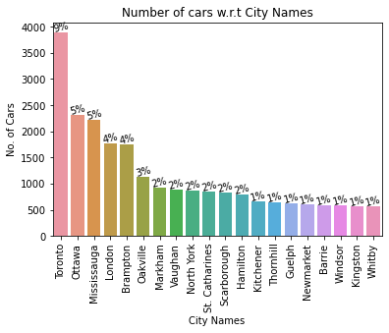
Key Insights:
Average Price Other Sellers = 1.6 times Private Seller Price
Average Price of Automatic cars> Manual Cars
Type of Seller | Average Price of cars(dollars)
Other | 27629
Private | 17027
Difference | 10602
Transmission | Average Price of cars(dollars)
Automatic | 26099
Manual | 21537
Difference | 4633
Top 20 percentage of Cars w.r.t Car Types
Top 20 percentage of Cars w.r.t City Names

Slide 8
Model Building: Price Prediction Model
Random Forest and XG Boost algorithms are used to build the model.
Split the data into train and test dividing into 80-20 percentage.
Calculating Mean Square Error and Mean Absolute Error for both the models.
Checking important features generated in the model for Random Forest and XG Boost.
Table below shows the train and test accuracy for both the models:
Model | Train Accuracy | Test Accuracy
Random Forest | 71.75% | 71.28%
XG Boost | 77.50% | 74.94%
As the test accuracy for XG Boost is higher than Random Forest, using that model for price prediction by keeping in mind the accuracy of the model.

Slide 9
Conclusion:
Applying Random Forest and XG Boost on the dataset because we are predicting price with nearly 86 features, so these algorithms seemed best to fulfil the purpose.
As the test accuracy and train accuracy are similar for both the models so it is neither underfitting nor overfitting.
Most Cars(nearly 95%) use gasoline as a fuel so most cars in the market are based on gasoline.
Nearly 67% cars belong low mileage category, so they are easy to sell.
Regular Cars have a higher sell percentage compared to luxury/premium cars.
Nearly 30% out of total cars that are listed for sell in last one month at Clutch are sold but there is no data for the cars that arrived prior to last one month.
Future Scope:
Perform Hyperparameter Tuning for Random Forest and XG Boost by dividing the data into train, test and validation.
Train the model using Neural Networks.
Need larger data (nearly one quarter) to understand the trend of cars sold.
Could build a model by combining various cars i.e. make into 3 categories.
Try building a classification model for predicting price by dividing into number of classes.
Could try using engine and color features while predicting if the data is unified and standardized.
To build a Time to sell model, need large data depending on various categories of cars and models.

